Slide 1
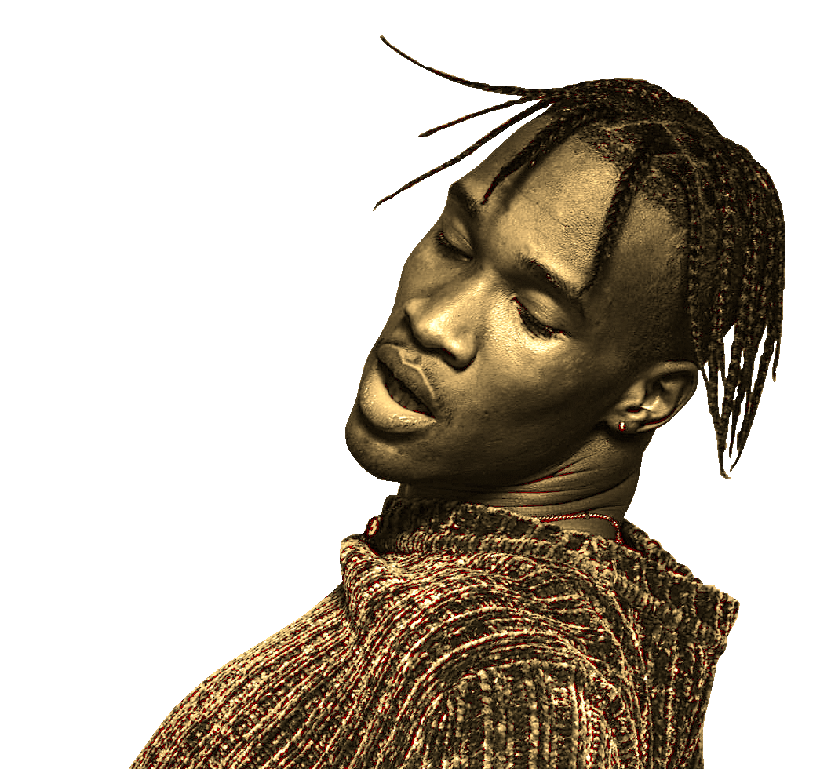

Spotify popularity predictor
By Andrew, trent, halam, and Max

Slide 2

CONTENTS
Introduction
Data Collection
Model ensemble
Api Integration
conclusion

Slide 3
introduction
From the beginning of music data analytics, professionals have been striving to create a model that accurately predicts an artist's career trajectory. However, despite efforts, such a model has not been achieved, and success is often determined by a self-fulfilling prophecy of the right team and budget.
Our product leverages structured data to provide a cutting-edge visualization of an artist's potential. By accurately predicting a song's likelihood to break into the top 50 hits in the USA with 75% accuracy, our model aims to be the first to discover the next big thing in music.

Slide 4

stats
$4 Billion invested annually in a&R
$500k-$2mm deployed per new artist
Record label

Slide 5
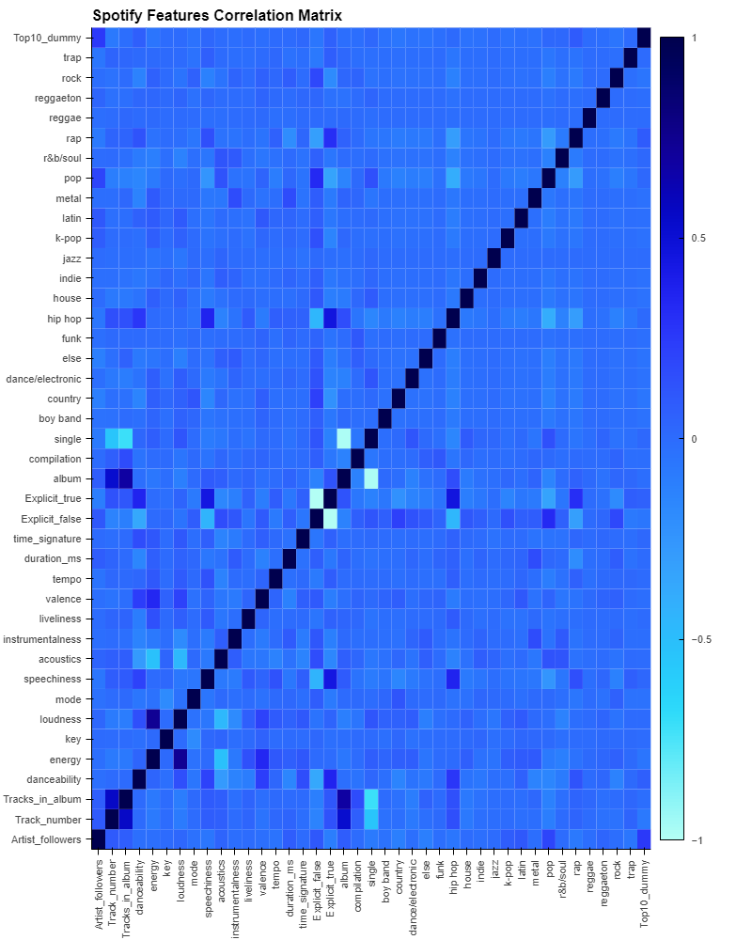
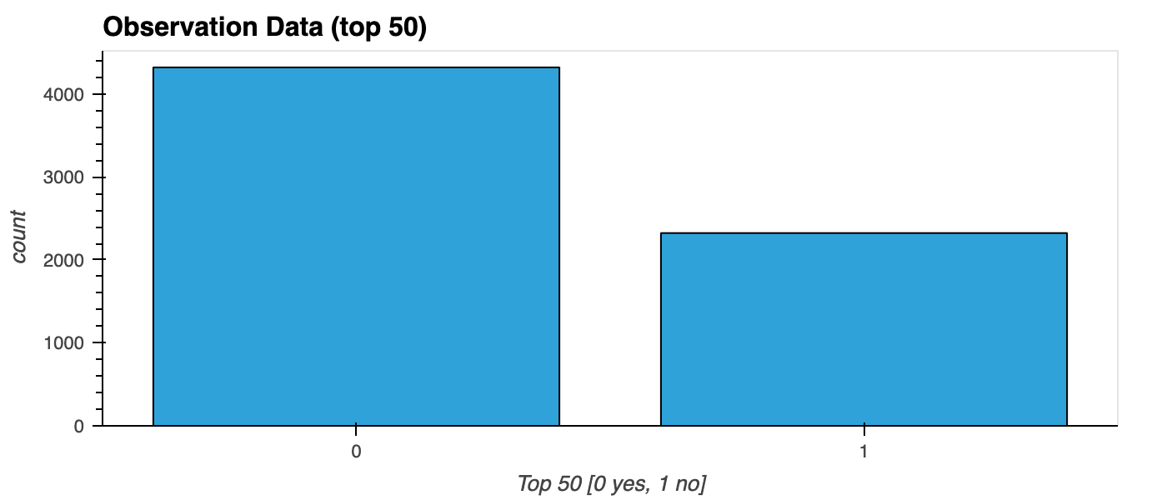
Data collection & Cleanup

Slide 6
Model ensemble
SVM
Decision tree
Random forest
Gradient boost
adaboost

Slide 7

Api integration

Slide 8
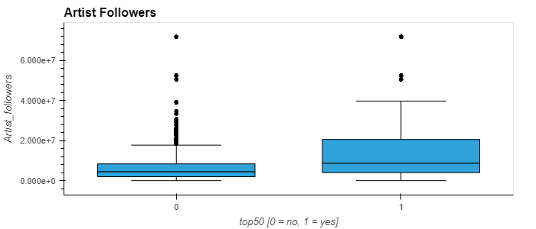
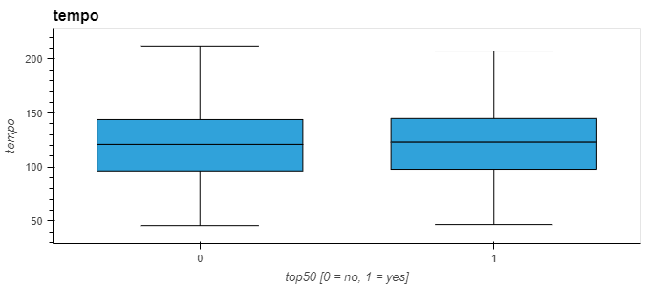
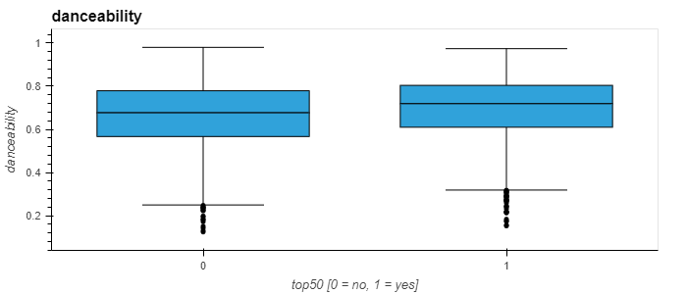
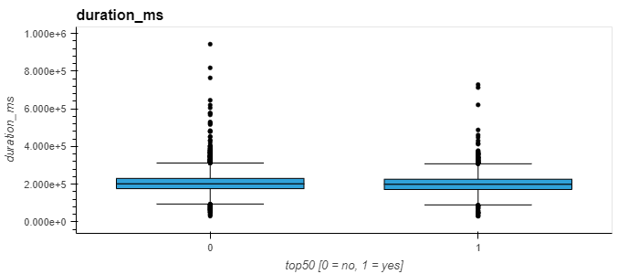
ARTIST FOLLOWERS
TEMPO
DANCEABILITY
DURATION

Slide 9
Where words fail, Music speaks.
Hans Christian Andersen

